Slide 1
Random Testing Framework
: Anvita Panjugula, Kaushik Bhamidipati

Slide 2
Introduction
Overview:
- Software testing ensures reliability but manual testing has limitations.
- Random Testing Framework automates diverse input testing.
Objective:
- Identify bugs and edge cases.
- Simplify testing through systematic reporting.

Slide 3
Problem statement & Motivation
Create a simple random testing tool that can automatically generate test cases for basic data types and simple functions, helping to find bugs and edge cases in programs.
Challenges of Manual Testing:
- Inefficient and time-consuming.
- Limited coverage for edge cases.
Framework Goals:
- Automate test case generation for multiple data types.
- Uncover bugs with random inputs.
- Provide detailed and easy-to-analyze reports.

Slide 4
Implementation
Core Components:
1. Random Input Generators:
- Supports integers, strings, arrays and floats.
2. Buggy Functions:
- Simulates real-world issues for testing.
3. Testing Framework:
- Automated test execution, error handling, and reporting.

Slide 5
buggy_function_int: Multiplies integers by 2 but enforces strict type checks.
buggy_function_string: Calculates string lengths but fails on empty strings.
buggy_function_array: Processes arrays, ensuring they are homogeneous (all elements of the same type).

Slide 6
Experimental Results
Results Summary:
- Conducted 150 tests per data type. (Can be changed)
- Failure cases (Sample):
- Integers: 10/150 failed due to non-integer values.
- Strings: 5/150 failed due to empty strings.
- Arrays: 20/150 failed due to unsupported types.

Slide 7
Comparison with Manual Testing VAAAutomated
Automated Testing:
- Efficiently uncovered edge cases.
- Comprehensive and faster.
Manual Testing:
- Time-consuming.
- Less effective in finding edge cases.
- Efficiency: Saves time through automation.
- Comprehensiveness: Broad test coverage.
- Reproducibility: Logs results for analysis.

Slide 8
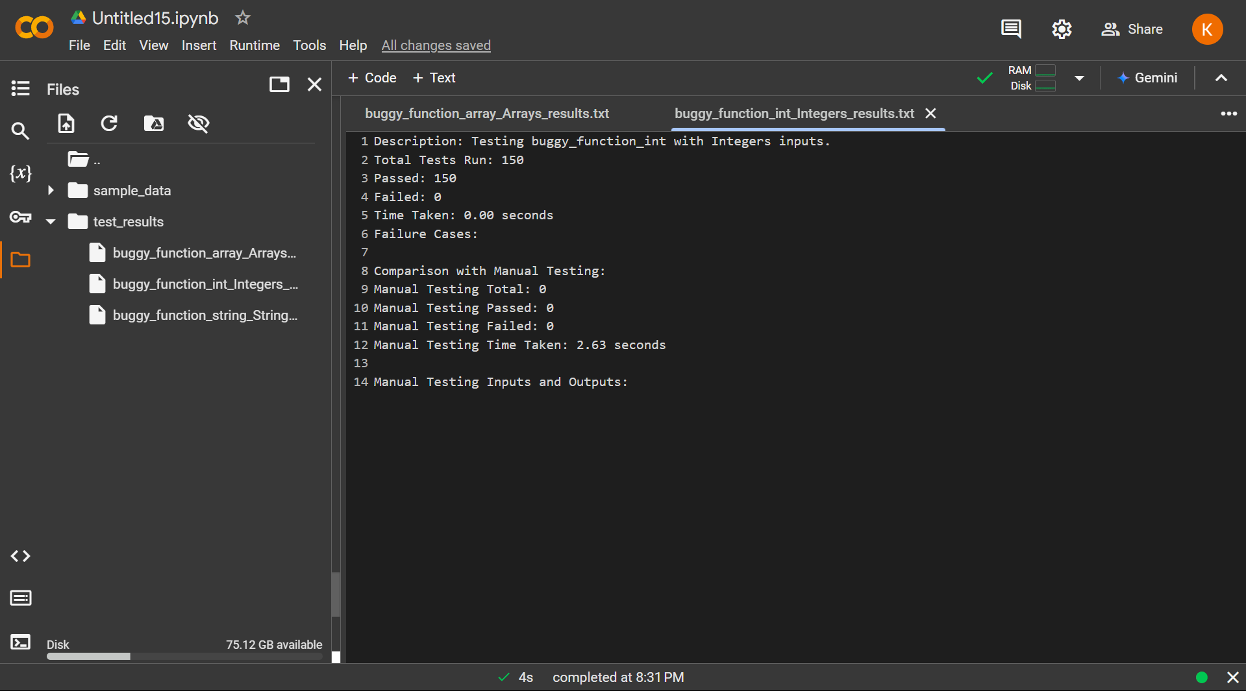
Integers

Slide 9
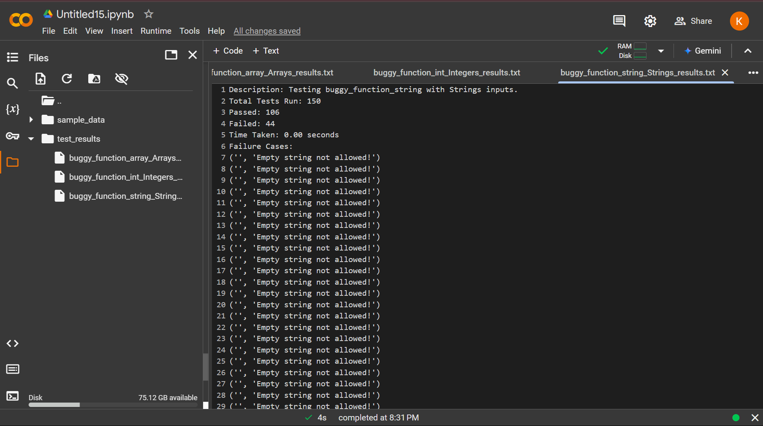
Strings

Slide 10
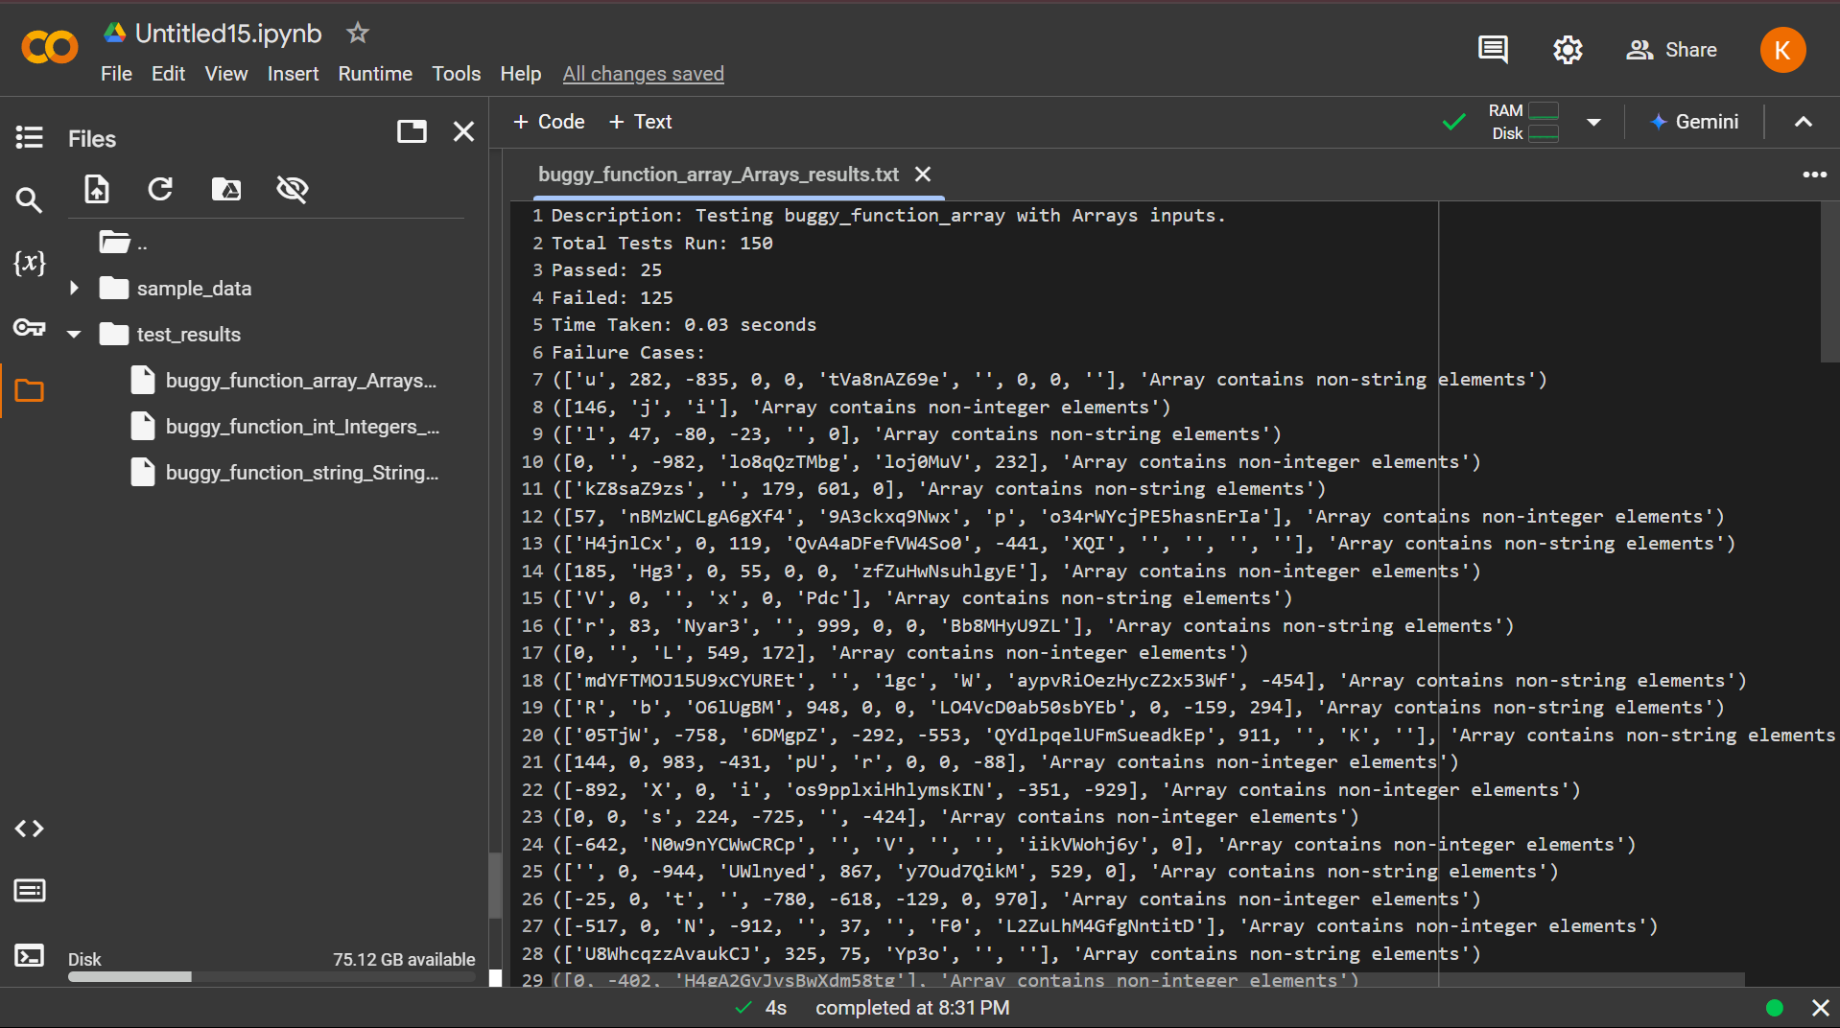
Arrays

Slide 11
Conclusion
Summary:
- Framework automates testing, enhancing reliability and efficiency.
- Ensures comprehensive coverage for multiple data types.
Future Directions:
- Extend support for complex data types.
- Integrate into CI/CD pipelines.

Slide 12
Thank you
https://github.com/anvitaxreddy/Random_Testing_Framework

